Slide 1
Drag & drop && canvas ? HanGman : ''
const team-AlIgMaRa = ['Alain Messerli', 'Igor Stojanovic', 'Marius Stalder', 'Raphael Gerber'];

Slide 2
Agenda
Hangman
Drag & Drop
Introduction
Basic Setup
Events
DataTransfer Object
Demos
Canvas
Introduction
Canvas API
Demos
WebGL
Introduction
Important Concepts in regard of WebGL
Demos

Slide 3
Drag & Drop: Definition
HTML Drag and Drop interfaces enable applications to use drag-and-drop features in browsers. The user may select draggable elements with a mouse, drag those elements to a droppable element, and drop them by releasing the mouse button. A translucent representation of the draggable elements follows the pointer during the drag operation
You can customize which elements can become draggable, the type of feedback the draggable elements produce, and the droppable elements.
Drag & Drop needs JS to Work!
Source: MDN

Slide 4
Basic Setup: Draggable
Images and text elements are draggable by default
To prevent unwanted action (e.g. opening an image directly by dragging it in the browser, you can prevent the default behavior)
<img draggable="true">
<p draggable="false">
Source: MDN

Slide 5
Basic Setup: Droppable
By default everything is droppable inside an input, textarea and elements where contenteditable is set
So the main question is if an element listens on a dropevent or not
<div id="target" ondrop="drop(event)"> </div>
Source: MDN

Slide 6
Drag & Drop Events (1/2)
Event | Event Handler | Is triggered when
dragstart | ondragstart | …the user starts dragging an item.
drag | ondrag | …a dragged item (element or text selection) is dragged.
dragend | ondragend | …a drag operation ends (such as releasing a mouse button or hitting the Esc key)
dragenter | ondragenter | …a dragged item enters a valid drop target.
dragleave | ondragleave | …a dragged item leaves a valid drop target.
Source: MDN

Slide 7
Drag & Drop Events (2/2)
Event | Eventhandler | Is triggered when
dragover | ondragover | …a dragged item is being dragged over a valid drop target, every few hundred milliseconds.
drop | ondrop | …an item is dropped on a valid drop target
Source: MDN

Slide 8
Drag & Drop Interfaces
The DragEvent interface is a DOM event that represents a drag and drop interaction. The user initiates a drag by placing a pointer device (such as a mouse) and then dragging the pointer to a new location (such as another DOM element).
The DragEvent interface has a constructor and one dataTransfer property, which is a DataTransfer object.
let data = dragEvent.dataTransfer;
Source: MDN

Slide 9
DataTransfer Object
The DataTransfer object is used to hold the data that is being dragged during a drag and drop operation. It may hold one or more data items (DataTransferItem), each of one or more data types.
DataTransfer objects include the drag event's state, such as the type of drag being done (like copy or move), the drag's data, and the MIME type of each drag item.
DataTransfer objects also have methods to add or remove items to the drag's data.
setData(format, data); sets the drag operation's data
getData(format); retrieves the drag operation's data
clearData([format]); removes the drag operation's data
setDragImage(); set the image to be used for dragging if a custom one is desired
Source: MDN

Slide 10
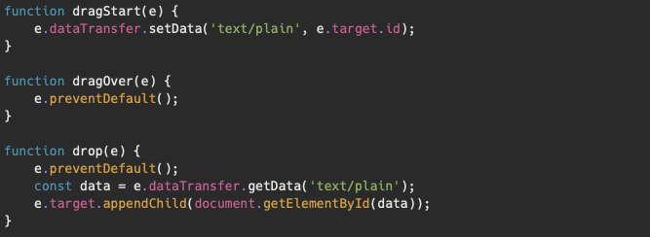
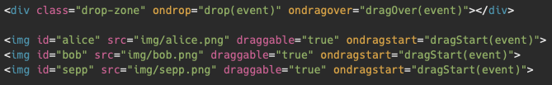
DataTransfer Example

Slide 11
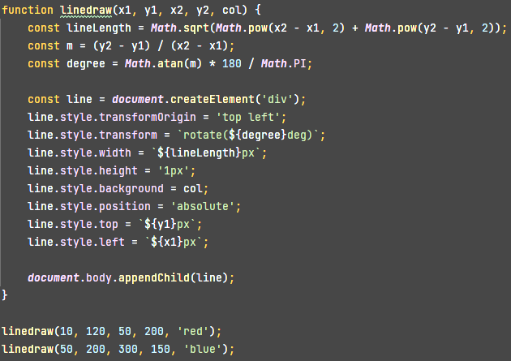
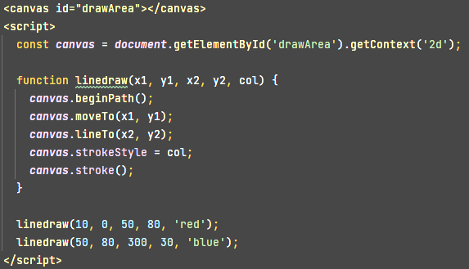
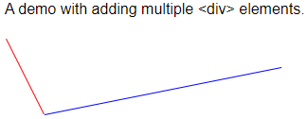
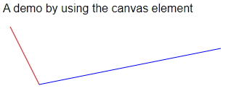
Canvas API : Introduction
How to draw something with JavaScript?
Possible solution: Manipulating the DOM, using <div> elements and style
Better: using a web API like the Canvas API

Slide 12

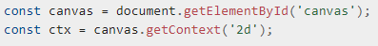
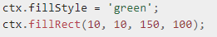
Canvas API : Introduction
Minimalistic setup
A canvas element on the DOM (HTML)
The «context» in JS
Some drawing
300px
0,0
+
150px
Source: https://developer.mozilla.org/en-US/docs/Web/API/Canvas_API#basic_example
Notes:
Height, default 150px
Width, default 300px

Slide 13
Canvas API : The <canvas> HTML element
Methods
getContext(type)
When called with type = ‘2d’ returns CanvasRenderingContext2D → Canvas API
When called with type = ‘webgl’ returns WebGLRenderingContext → WebGL
toDataURL(type, encoderOptions)
Returns a data URL containing an image representation (96dpi)
Default type is ‘image/png’, other possibilities are ‘image/jpeg’ and ‘image/webp’
encoderOptions can specify the image quality when using lossy compression, number between 0 and 1, default: 0.92
toBlob(callback, mimeType, qualityArgument)
Source: https://developer.mozilla.org/en-US/docs/Web/API/HTMLCanvasElement/getContext and toDataURL

Slide 14
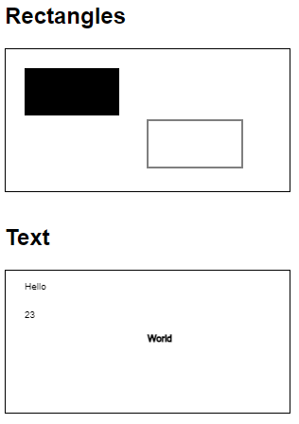
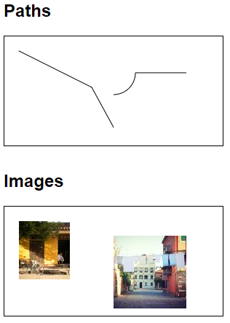
Canvas API : Drawing
Notes:
Other drawing methods:
bezierCurveTo() https://developer.mozilla.org/en-US/docs/Web/API/CanvasRenderingContext2D/bezierCurveTo
ellipse() https://developer.mozilla.org/en-US/docs/Web/API/CanvasRenderingContext2D/ellipse
quadraticCurveTo() https://developer.mozilla.org/en-US/docs/Web/API/CanvasRenderingContext2D/quadraticCurveTo

Slide 15
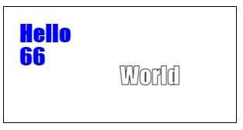
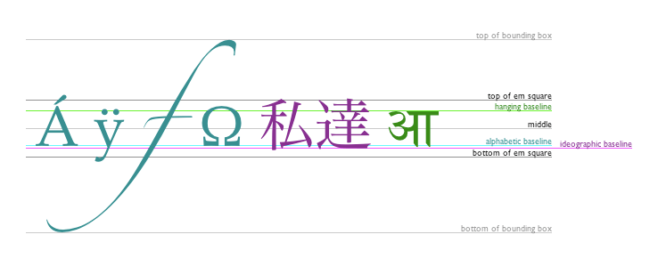

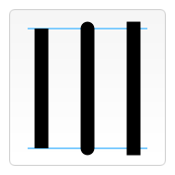

Canvas API : Styles
Text styles
font
textAlign
textBaseline
direction
Line styles
linewidth, number, 1.0
lineCap, ‘butt’, ‘round’, ‘square’
lineJoin, ‘round’, ‘bevel’, ‘miter’
miterLimit, number, 10.0
Dash pattern: getLineDash(), setLineDash(), lineDashOffset
Source: https://developer.mozilla.org/en-US/docs/Web/API/CanvasRenderingContext2D#line_styles

Slide 16

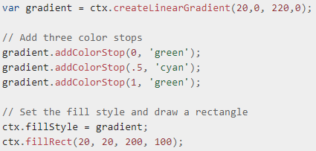

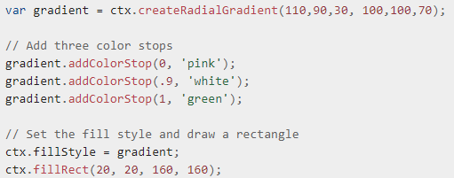
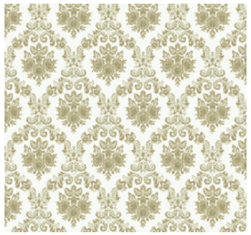
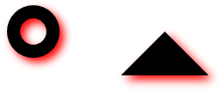
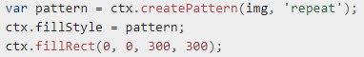
Canvas API : Styles
Fill and stroke styles
Could be a color or a style
Gradients
Linear gradient
Radial gradient
Pattern
Shadow
Source: https://developer.mozilla.org/en-US/docs/Web/API/CanvasRenderingContext2D#fill_and_stroke_styles and #gradients_and_patterns

Slide 17
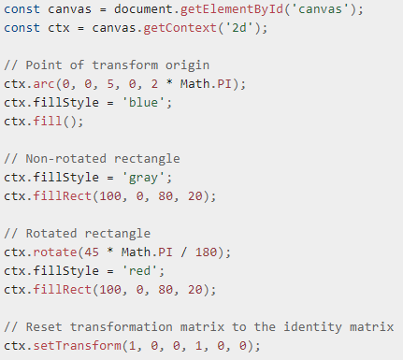
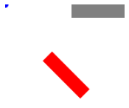
Canvas API : Manipulation
Transformations
Applied to the whole CanvasRenderingContext2D
Methods: rotate(), scale(), translate(), transform()
Source: https://developer.mozilla.org/en-US/docs/Web/API/CanvasRenderingContext2D/rotate

Slide 18
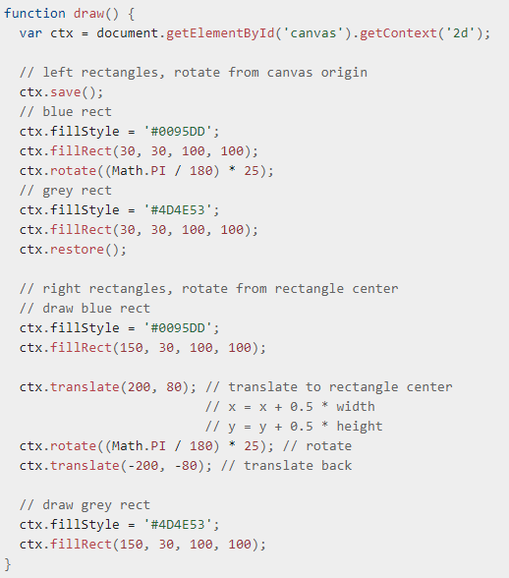

Canvas API : Manipulation
The canvas state can be stored and retrieved on a stack (line, fill, shadow and text styles, dash list, transformation matrix, …)
Methods: save() and restore()
Source: https://developer.mozilla.org/en-US/docs/Web/API/Canvas_API/Tutorial/Transformations

Slide 19
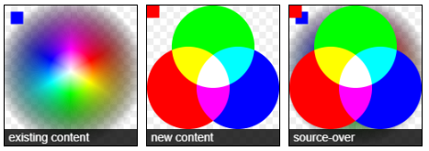
Canvas API : Other possibilities
Changing compositing operation (how new shapes are applied to the canvas)
Animations
Image manipulation
Video manipulation
Source: https://developer.mozilla.org/en-US/docs/Web/API/CanvasRenderingContext2D/globalCompositeOperation#types

Slide 20



WebGL
Disclaimer: „We are no experts in Graphic processing“
Notes:
- Webgl: API zur hardware beschleunigten *D-Grafik berechnung (Version 1.0 und 2.0)
Basiert auf OpenGL
- Wird abgelöst durch WebGPU (von W3C entwickelt) -> WebGPU basiert nicht auf OpenGL -> an Vulkan angelehnt

Slide 21
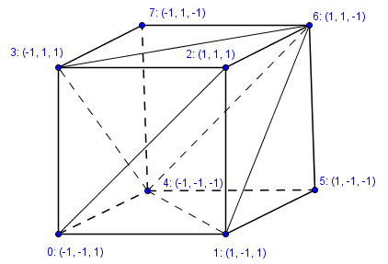
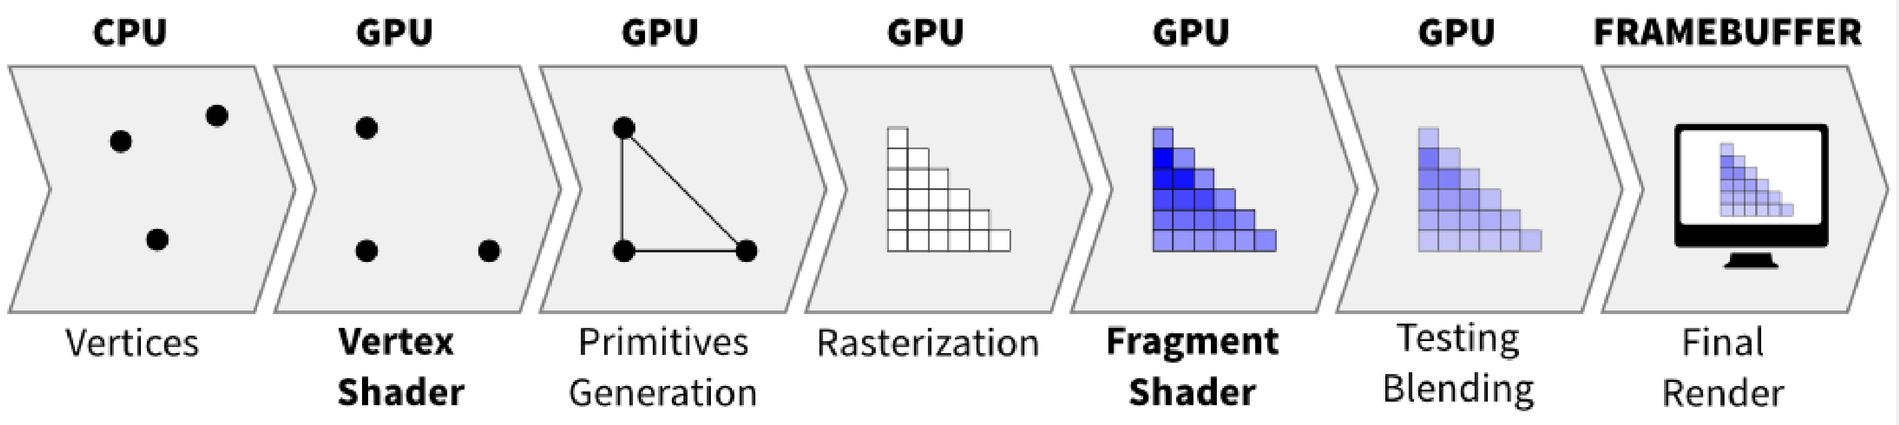
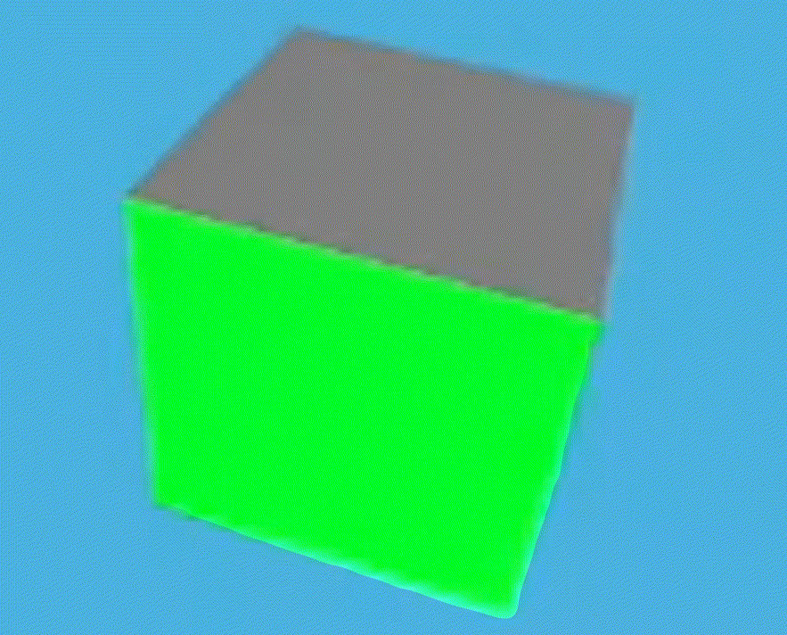
Rendering Pipeline
ACTIVATE
Data
GLSL
Draw
GLSL
Data: Points in 3D-Space to be drawn
GLSL: Shader-Code in text form
Draw: Instruction for drawing shape (Point, Line, Polygon, Triangle, Quad; Fan, Strip)
Transformation: (World-, View-, Projectionmatrix)

Slide 22
Shader-Program (GLSL)
Inputs
export const vsSource = ` attribute vec3 vertPosition; attribute vec3 vertColor; uniform mat4 uWorldMatrix; uniform mat4 uViewMatrix; uniform mat4 uProjectionMatrix; varying vec3 fragColor; void main() { fragColor = vertColor; gl_Position = uProjectionMatrix * uViewMatrix * uWorldMatrix * vec4(vertPosition, 1.0); } `;
Shader
Program
Konstanten
„Variablen“
Compile
Global
Link
export const fsSource = ` precision mediump float; varying vec3 fragColor; void main() { gl_FragColor = vec4(fragColor, 1.0); } `;
Shader
Compile
Global

Slide 23
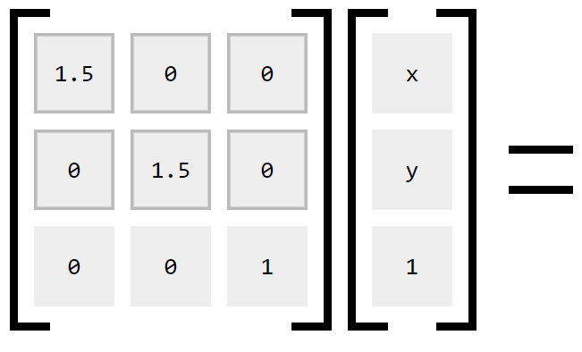
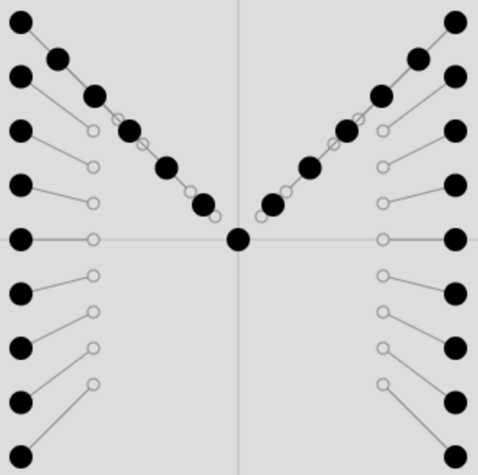
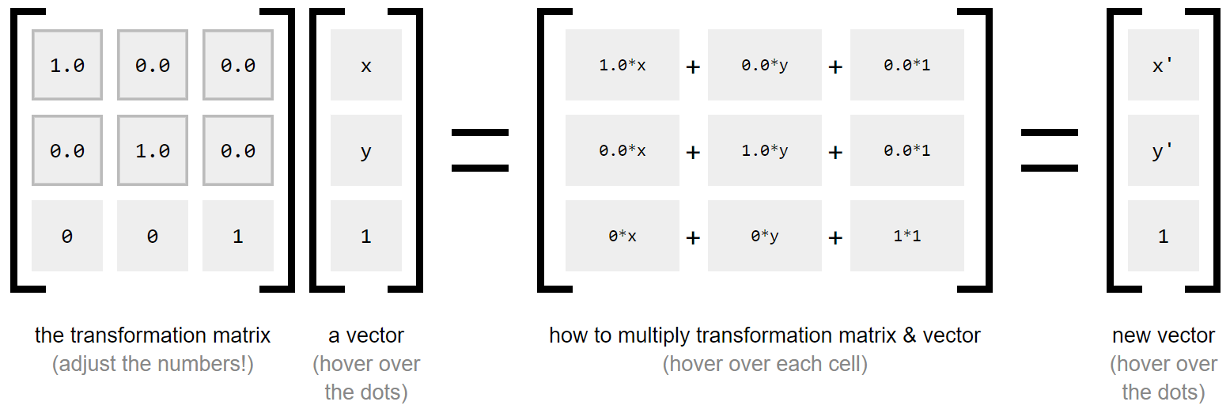
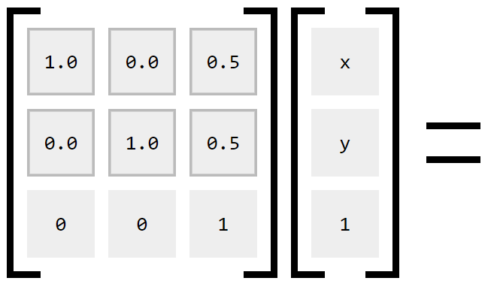
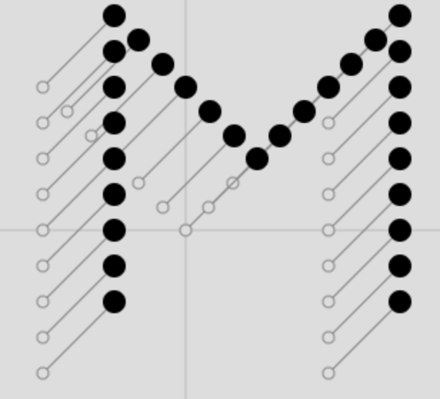
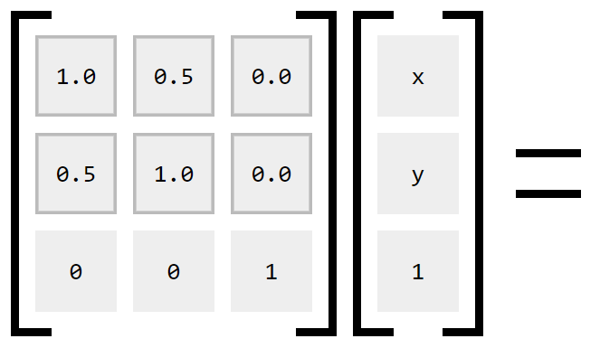
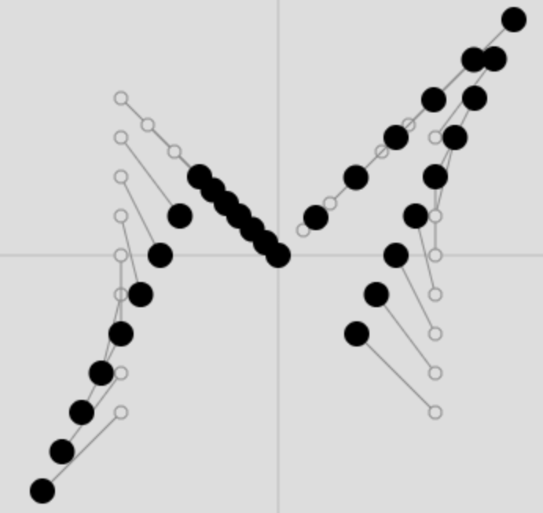
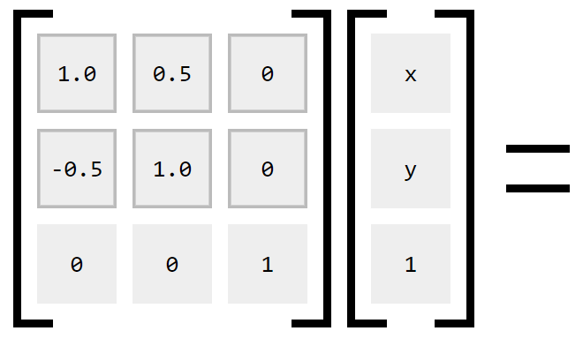
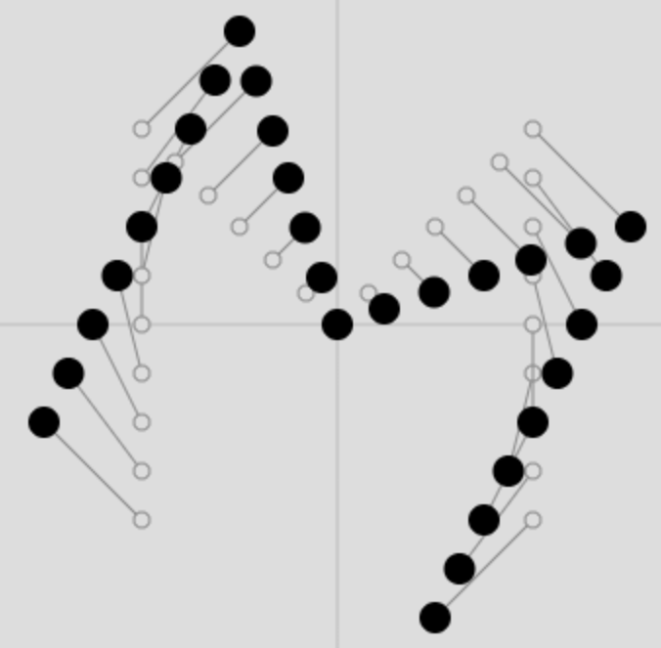
Transformation-Matrix
Scaling
Translation
Shear
Rotation
cos(α)
sin(α)
-sin(α)
cos(α)
Source:
https://ncase.me/matrix

Slide 24
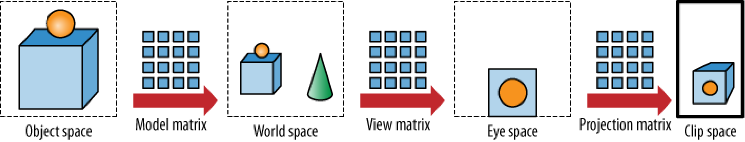
Model View Perspective
Position and orientation in the room
Position und direction of the viewer (Camera)
Field of View
Aspect Ration
Project the Points in the 3D Space to 2D surface.

Slide 25
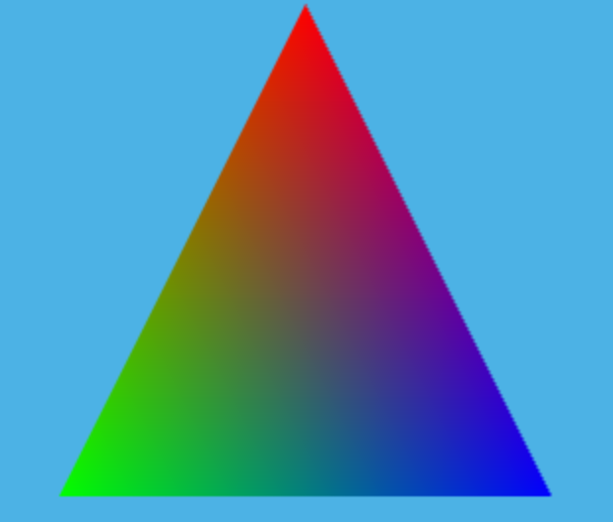
Data (Vertices) / Buffer
let triangleVertexes = [// X.x, Y.y, Z.z, R.r, G.g, B.b 0.0, 0.5, 0.0, 1.0, 0.0, 0.0, -0.5, -0.5, 0.0, 0.0, 1.0, 0.0, 0.5, -0.5, 0.0, 0.0, 0.0, 1.0, ]
let triangleVertexBufferObject = gl.createBuffer(); gl.bindBuffer(gl.ARRAY_BUFFER, triangleVertexBufferObject); gl.bufferData(gl.ARRAY_BUFFER, new Float32Array(triangleVertexes), gl.STATIC_DRAW); /* Get Attribute Handles Attributes are the "parameters" for the GLSL programs we need a reference to these input params */ let positionAttributeLocation = gl.getAttribLocation(program, 'vertPosition'); let colorAttributeLocation = gl.getAttribLocation(program, 'vertColor');
gl.vertexAttribPointer( positionAttributeLocation, // Attribute Location 3, // Number of elements each attribute has (X,Y,Z) gl.FLOAT, // Type of elements gl.FALSE, // Is 6 * Float32Array.BYTES_PER_ELEMENT, // Sitze of a vertex 0// Offset of the beginning of vertex )
gl.vertexAttribPointer( colorAttributeLocation, // Attribute Location 3, // Number of elements each attribute has (R,G,B) gl.FLOAT, // Type of elements gl.FALSE, // Is 6 * Float32Array.BYTES_PER_ELEMENT, // Sitze of a vertex 3 * Float32Array.BYTES_PER_ELEMENT// Offset of the beginning of vertex )

